Slide 1



Slide 2
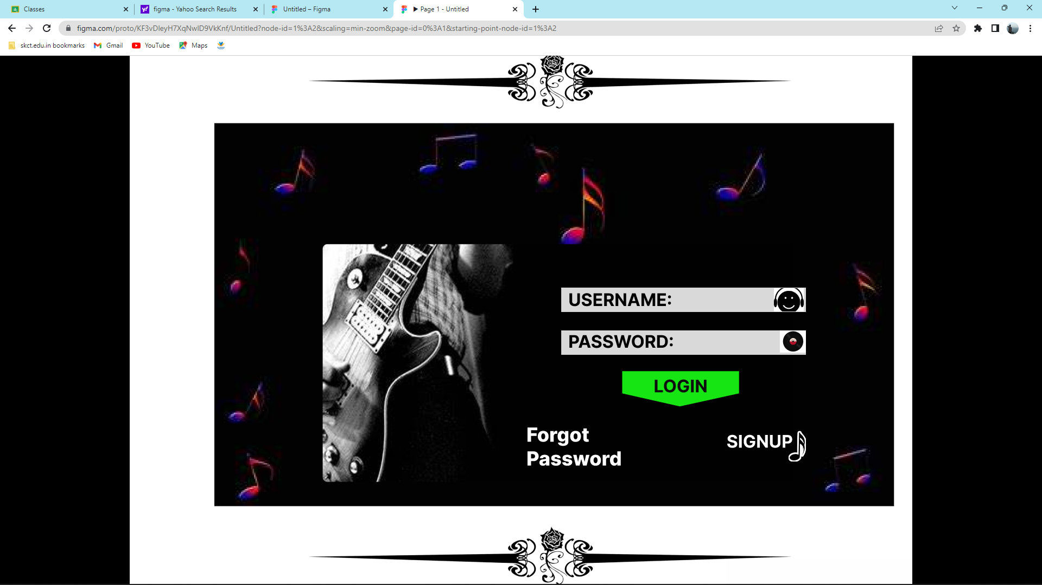

Slide 3
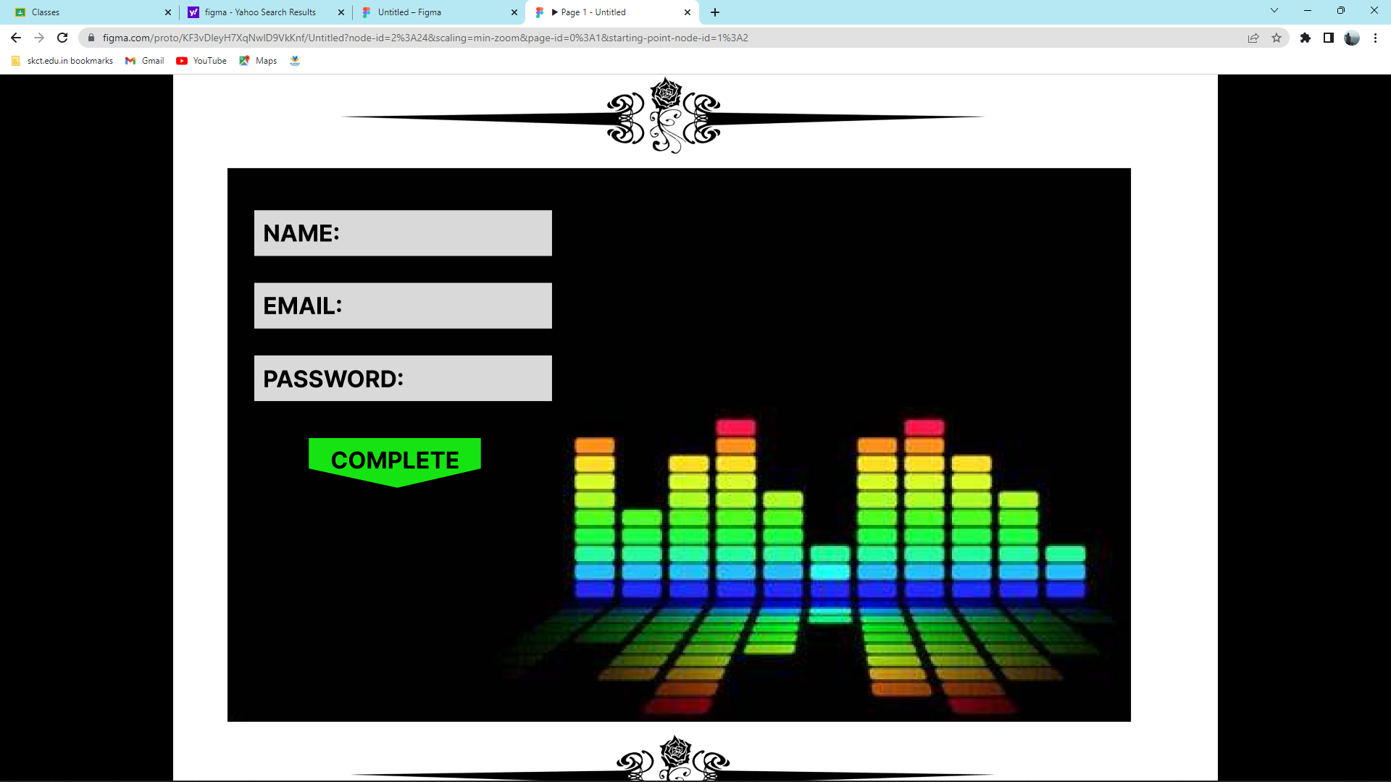

Slide 4
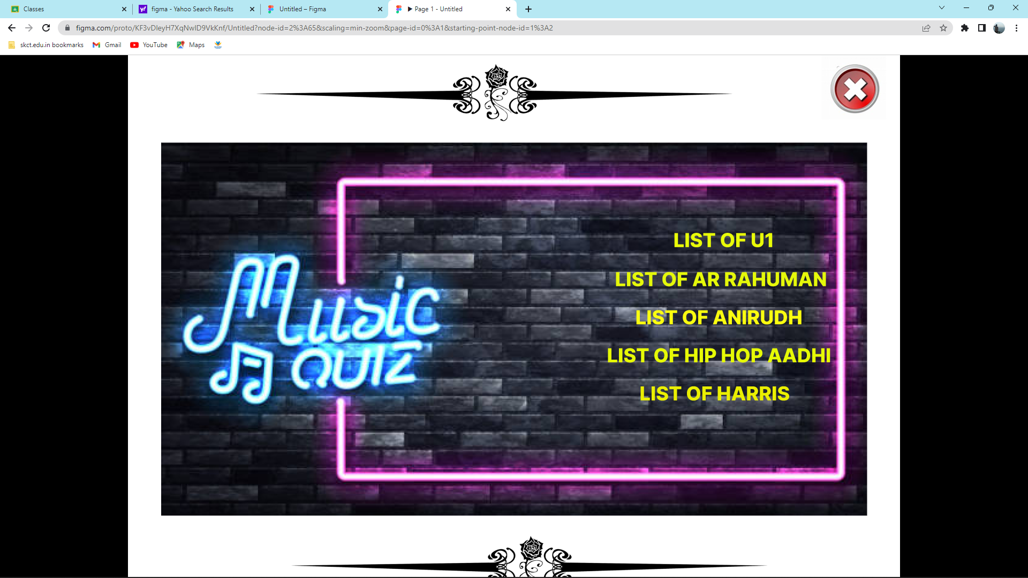

Slide 5
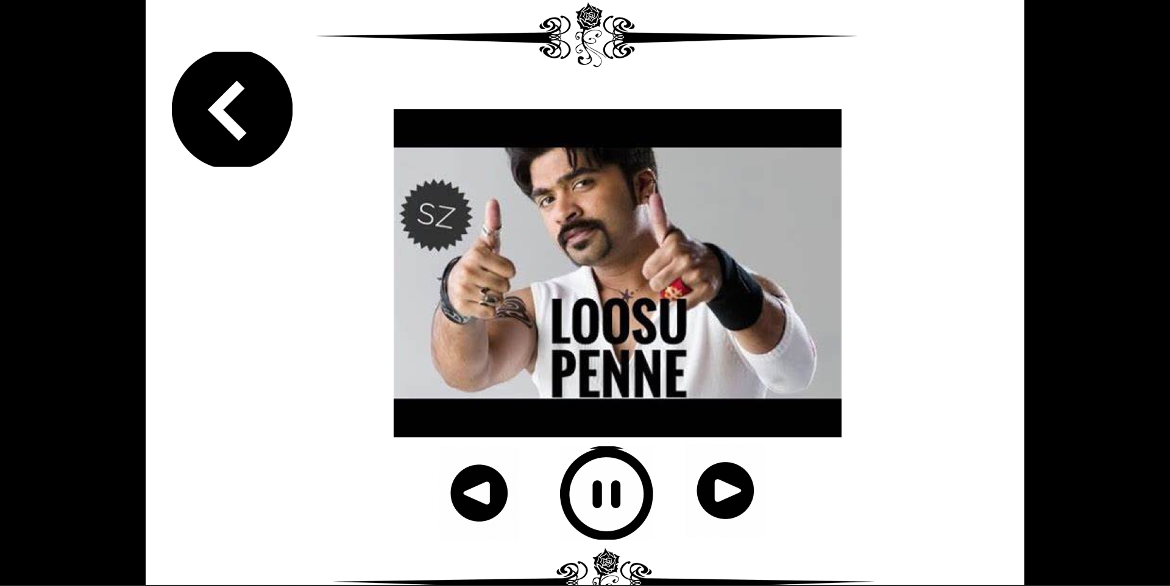

Slide 6
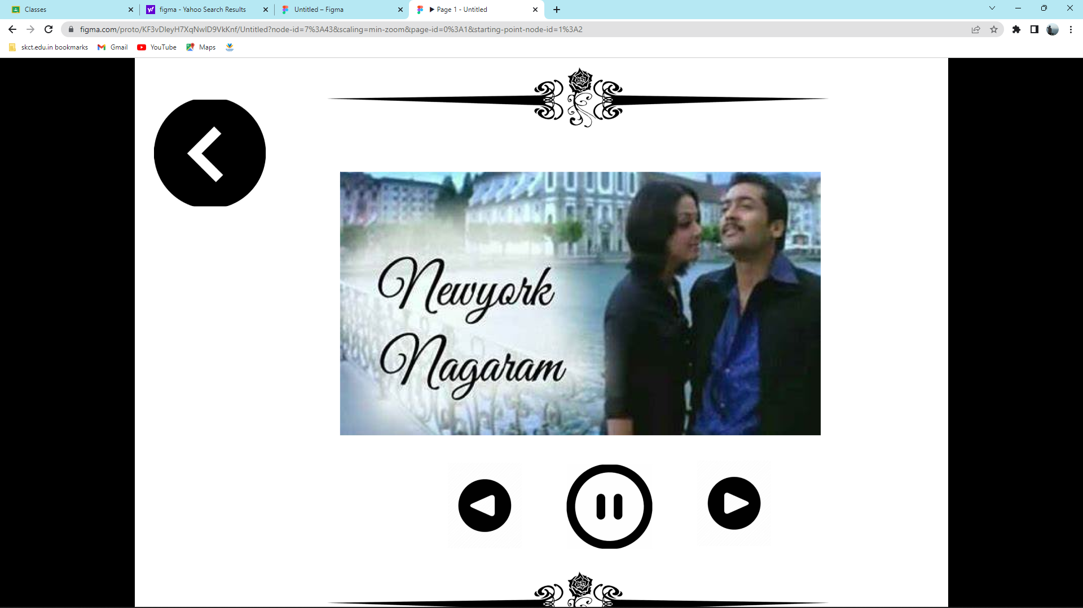

Slide 7
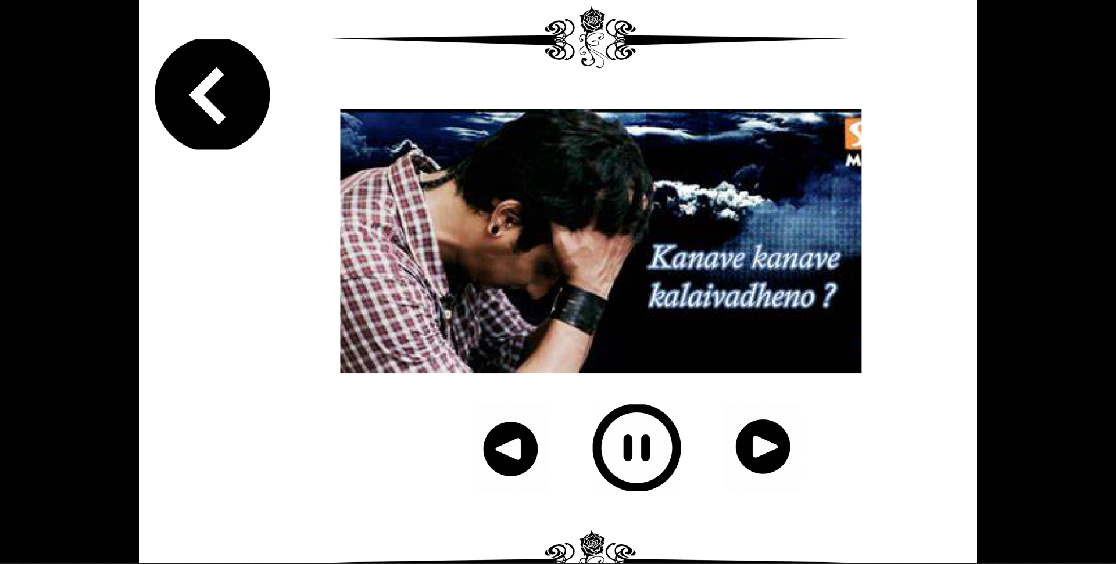

Slide 8
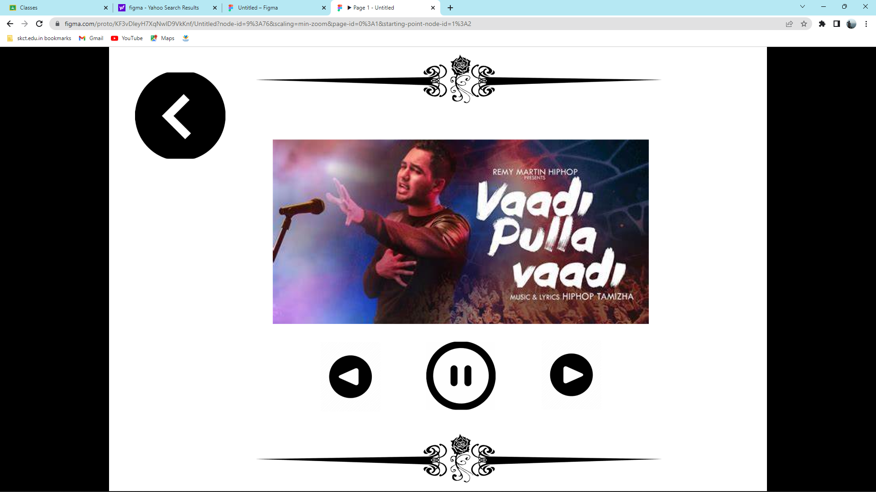

Slide 9
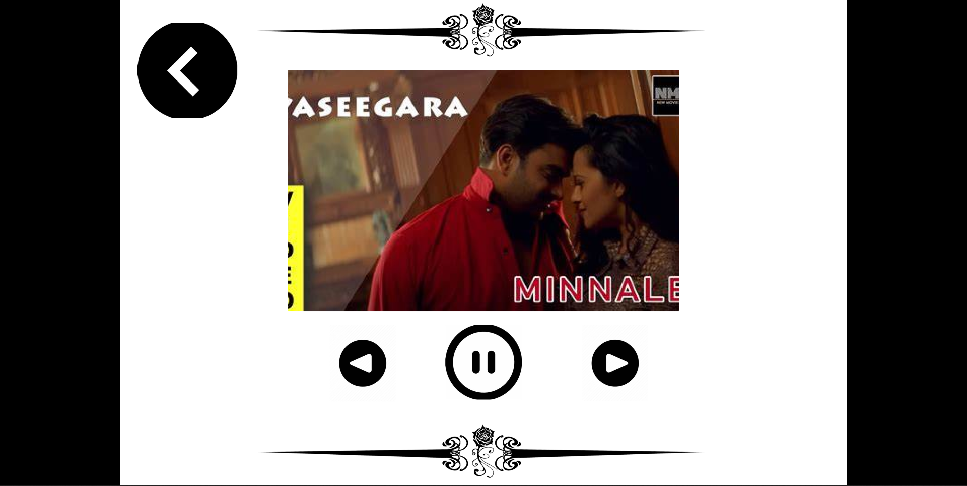

Slide 10
https://www.figma.com/file/KF3vDleyH7XqNwlD9VkKnf/Untitled?node-id=0%3A1

Slide 11

BY
TEAM
PROSTARS

